Slide 1
NSS Tourism Agency Presents: Halloween Pedal Tavern

Slide 2
Burials per year
Notes:
Hit its peak during the Civil War years. Notable the Battle of Nashville which occurred December 15 to December 16, 1864
One of the largest victories achieved by the Union and Nashville City Cemetery largely contains Union troops
3000 union troops and approx, 1500 confed troops (with another 4500 confed troops missing/captured)

Slide 3
Top 10 causes of death
Notes:
Consumption – aka TB
Cholera – summer
Dropsy – aka edema

Slide 4
Top 5 causes of deaths by month
Notes:
Still born – red – most consistent through all months
Cholera – summer hot temps and rain accelerate bacteria growth in drinking water supply
Cold in the winter months Dec-Feb
Consumption – consistent all year
Pnuemonia in white – winter early spring

Slide 5

Burials by gender and decade: Civil War
Notes:
Males accounted for 52-54% of the deaths during and before the Civil War

Slide 6
Burials by gender and decade: Post Civil War
Notes:
The gender makeup burials shifted in the decades after the civil and are a better representation of the US male to female ratio

Slide 7
Deaths by age bracket
Pre 1880
1881 - 1900
1900 - 1920
After 1920
Notes:
The breakdown of deaths by age bracket also show dramatic swings between the Civil war and post Civil war eras.
Pay attention to the deaths in the 3 age brackets 40 and younger vs the 2 brackets 41 or older.
CW: 66% ; 34
1900: 40%; 60
1920: 22%; 78
After 20: 16%; 84

Slide 8
Cemetery demographics
Infants account for 59% of the burials

Slide 9
Cemetery demographics
Most common last names
Smith
Brown
Johnson
Jones
Williams

Slide 10
Cemetery demographics
Notes:
65/35 split

Slide 11
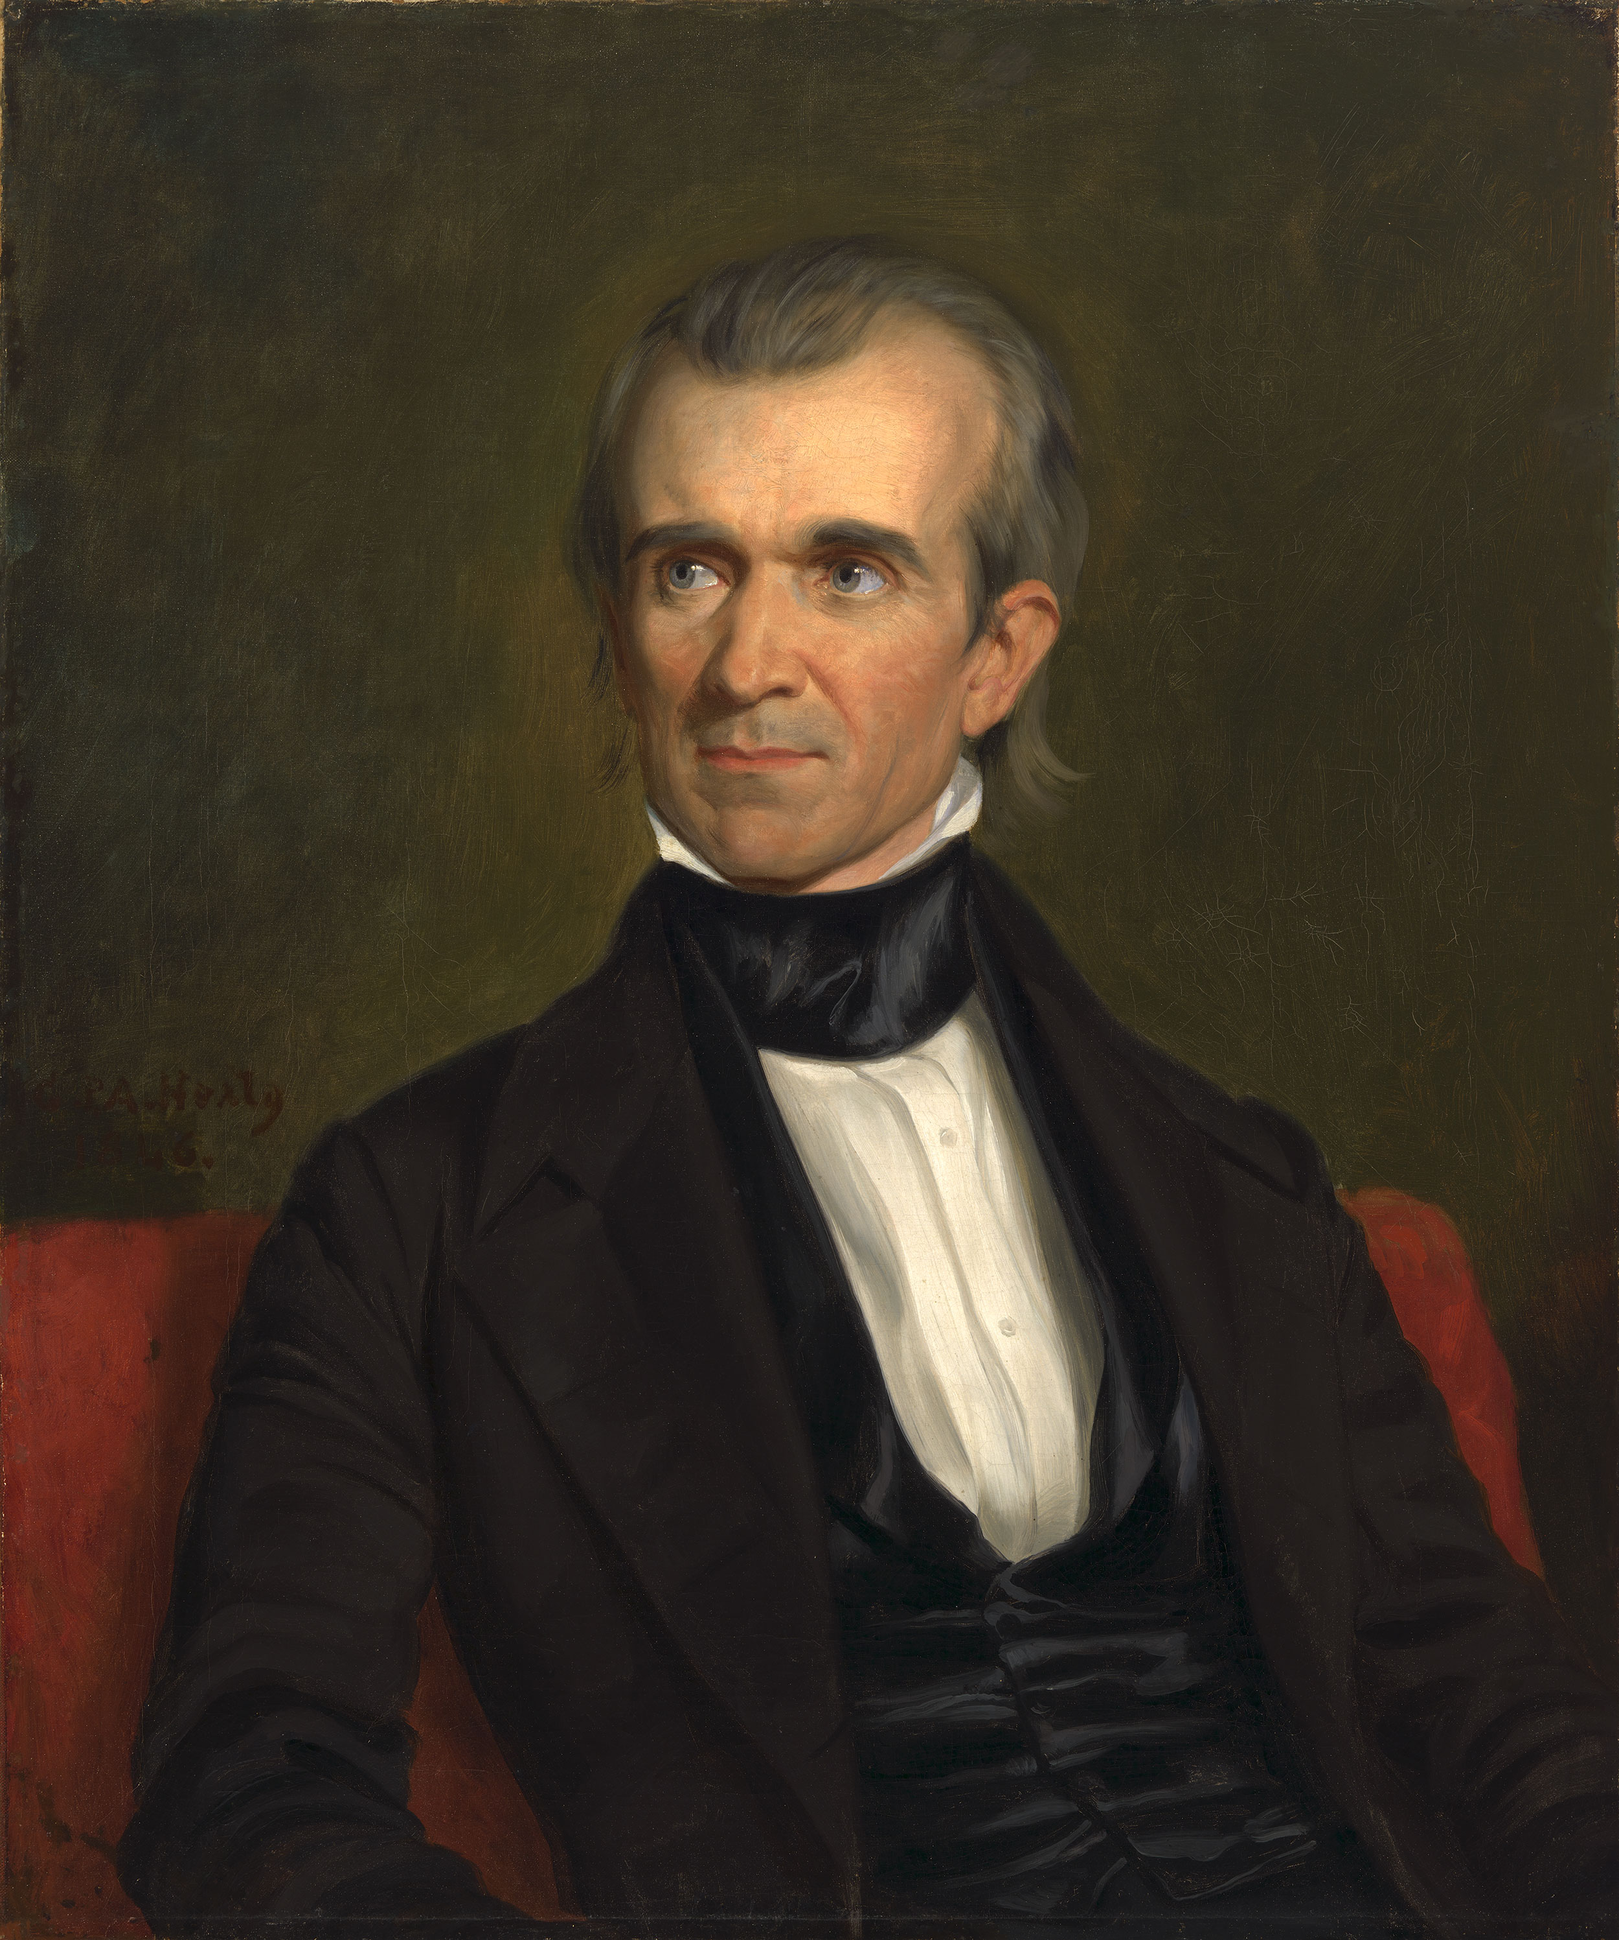
Fit for a President?
Notes:
After his death, he was buried in what is now Nashville City Cemetery, due to a legal requirement related to his infectious disease death. Polk was then moved to a tomb on the grounds of Polk Place (as specified in his will) in 1850.^{[258]}
Then, in 1893, the bodies of James and Sarah Polk were relocated to their current resting place on the grounds of the Tennessee State Capitol in Nashville.
March 2017, the Tennessee Senate approved a resolution considered a "first step" toward relocating the Polks' remains to the family home in Columbia;
three different times since his death; however, a year later, it subsequently was declined by Tennessee lawmakers before being taken up again being approved and reaching unsigned approval by Tennessee governor Bill Haslam.^{[260][261]}

Slide 12
Happy Halloween!

